Slide 1
BioMed-Scribe
Fine-Tuning GPT-2 for Medical Specialty
Classification from Clinical Conversations
Samuel Bonney
Department of Mathematics · Illinois State University
Advisor: Dr. Maochao Xu
MAT 411 · Spring 2025

Slide 2
Motivation
Why automate medical specialty classification?
⏱ Triage Bottleneck
📋 EHR Routing
💻 Telemedicine
Physicians spend critical time routing patients to the right specialist — time that could be spent on care.
Hospitals process millions of clinical notes. Automated specialty tagging enables faster retrieval, billing, and research.
When a patient types symptoms into a telehealth app, the classifier routes them to the right specialist instantly.
The solution: Fine-tune GPT-2 Medium to classify conversations into 4 specialties — Cardiology, Neurology, Orthopedics, General Medicine
BioMed-Scribe | Samuel Bonney | Illinois State University | MAT 411

Slide 3
Dataset
13,492 labeled doctor-patient conversations
Data Sources
Dataset Split (80 / 10 / 10 stratified)
Specialty | Train | Val | Test
Cardiology | 2,512 | 314 | 314
Neurology | 2,129 | 265 | 267
Orthopedics | 2,952 | 370 | 369
General Medicine | 3,200 | 400 | 400
Total | 10,793 | 1,349 | 1,350
AGBonnet/augmented-
clinical-notes
30,000 records
22,068 usable
HuggingFace dataset
ChatDoctor-
HealthCareMagic-100k
112,165 Q&A pairs
4,000 added
HuggingFace dataset
Keyword labeling assigns specialty
when ≥1 keyword matched.
General Medicine is the default.
BioMed-Scribe | Samuel Bonney | Illinois State University | MAT 411

Slide 4
Model Architecture
GPT2MedicalClassifier — follows GPT2BinaryClassifier pattern
Input Conversation
(512 tokens)
Architecture Key Facts
354.8M
Total Parameters
1024
Hidden Dimension
GPT-2 Backbone
(Blocks 0–22)
330M params — FROZEN
12.6M
Trainable (3.5%)
24
Transformer Blocks
342.2M
Frozen
16
Attention Heads
Final Block h[23]
+ Layer Norm ln_f
12.6M — TRAINABLE
Last Token
Hidden State
(1024-dim)
Linear (1024→4)
+ Softmax
CLASSIFIER HEAD
Dropout
p = 0.1
BioMed-Scribe | Samuel Bonney | Illinois State University | MAT 411

Slide 5
Training Setup
15 epochs · A100 GPU · Two-phase learning rate schedule
Hyperparameters
Validation Accuracy Progression
Base Model:
GPT-2 Medium (345M)
Max Token Length:
512
Batch Size:
16 (eff. 32 w/ accum)
Optimizer:
AdamW (wd = 0.01)
LR Phase 1 (ep 1–5):
5 × 10⁻⁵
LR Phase 2 (ep 6–10):
5 × 10⁻⁵
LR Phase 3 (ep 11–15):
1 × 10⁻⁵
Warmup Steps:
84
Grad Clip:
1.0
Sampler:
WeightedRandomSampler
BioMed-Scribe | Samuel Bonney | Illinois State University | MAT 411

Slide 6
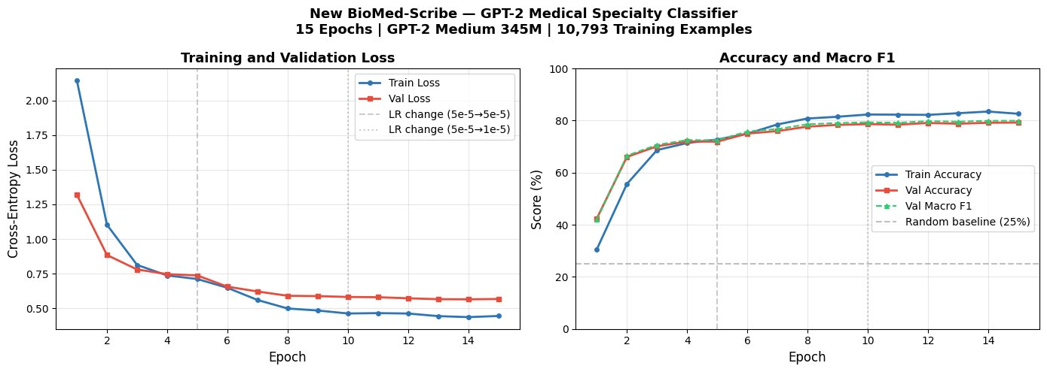
Training Curves
15 epochs · Val loss and accuracy tracked every epoch · Two-phase LR schedule
Left: Train loss (blue) and Val loss (red) decline smoothly — no overfitting gap. Right: Val accuracy from 42.4% → 79.2% across 15 epochs, beating random baseline (25%) 3×.
BioMed-Scribe | Samuel Bonney | Illinois State University | MAT 411

Slide 7
Results
Test accuracy 77.3% · Macro F1 0.782 · All classes improved vs. baseline
77.3%
0.782
0.877
0.673
Test Accuracy
Macro F1
Neurology F1
(Best class)
Gen. Medicine F1
(Hardest)
Classification Report (Test Set)
vs. Baseline
Specialty | Precision | Recall | F1
Cardiology | 0.801 | 0.844 | 0.822
Neurology | 0.857 | 0.898 | 0.877
Orthopedics | 0.743 | 0.773 | 0.758
General Medicine | 0.715 | 0.635 | 0.673
Macro avg | 0.779 | 0.788 | 0.782
Test Accuracy
74.5%
→
77.3%
Macro F1
0.743
→
0.782
Neurology F1
0.819
→
0.877
Orthopedics F1
0.693
→
0.758
Gen. Med. F1
0.663
→
0.673
BioMed-Scribe | Samuel Bonney | Illinois State University | MAT 411

Slide 8
Error Analysis
Confusion matrix reveals clinically explainable error patterns
Confusion Matrix (Test Set, n=1,350)
Key Findings
Cardio
Neuro
Ortho
Gen Med
Cardio
265
4
13
32
✅ Neurology (89.8%)
Strongest class. Neurological vocabulary (headache, seizure, stroke) is highly distinctive.
Neuro
5
239
9
13
✅ Cardiology (84.4%)
Strong performance. 32 cases confused with Gen. Medicine due to dyspnea overlap.
Ortho
16
12
286
56
⚠️ Orthopedics (77.3%)
Gen Med
45
24
77
254
56 cases predicted as Gen. Medicine — back pain and fatigue appear in both specialties.
⚠️ Gen. Medicine (63.5%)
Hardest class. 77 cases predicted as Orthopedics due to musculoskeletal overlap.
BioMed-Scribe | Samuel Bonney | Illinois State University | MAT 411

Slide 9
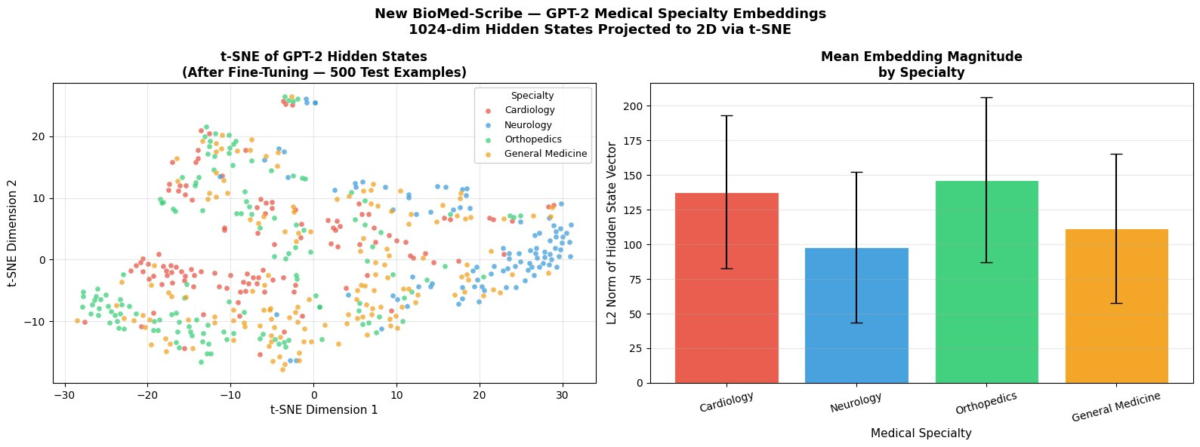
Embedding Analysis
t-SNE of 1024-dim GPT-2 hidden states — fine-tuning creates specialty clusters
Neurology tightest cluster — neurological vocabulary is most distinctive
Orthopedics separates lower-left — anatomical terms well separated
Cardiology + Gen. Med. overlap in centre — mirrors their confusion matrix errors
BioMed-Scribe | Samuel Bonney | Illinois State University | MAT 411

Slide 10
Embedding Analysis Cont.
t-SNE of 1024-dim GPT-2 hidden states — fine-tuning creates specialty clusters
What This Shows
Mean Embedding Magnitude (L2 Norm)
From the Transformer paper (Vaswani et al. 2017):
Self-attention allows each token to attend to all others, building a 1024-dim contextual representation of the full conversation.
Neurology forms the tightest cluster — neurological vocabulary is most distinctive.
Orthopedics separates toward lower-left — anatomical terms (knee, hip, fracture) are well-separated.
Cardiology + Gen. Medicine overlap in centre — mirrors their confusion matrix errors.
Conclusion: Fine-tuning teaches GPT-2 to develop specialty-specific internal representations.
New BioMed-Scribe | Samuel Bonney | Illinois State University | MAT 411

Slide 11
Live Demo
Gradio UI — real-time specialty prediction with confidence scoring
🏥 New BioMed-Scribe — Medical Specialty Classifier
Predicted Specialty
Doctor-Patient Conversation
❤️ Cardiology
Doctor: What is the problem?
Patient: I have chest pain going down
my left arm for the past hour and I am
sweating a lot.
Doctor: Any history of heart problems?
Patient: Yes, high blood pressure for years.
100% confidence
Confidence Scores
Cardiology
100%
General Medicine
0%
Neurology
0%
Orthopedics
0%
⚡ Classify Specialty
🔗 LIVE
DEMO
[New BioMed-Scribe]
BioMed-Scribe | Samuel Bonney | Illinois State University | MAT 411

Slide 12
Conclusion & Future Work
What’s Built
What’s Found
Future Work
GPT-2 Medium fine-tuned on 10,793 labeled clinical conversations
Only 12.6M of 354.8M parameters trained (3.5%)
77.3% test accuracy · Macro F1 = 0.782
Deployed as interactive Gradio application
Fine-tuning induces specialty-specific hidden state clusters
Neurology has clearest separation (F1 = 0.877)
Gen. Medicine ↔ Orthopedics confusion is clinically explainable
Longer sequences (512 vs 256 tokens) improve all metrics
Expand to 8+ specialties (Psychiatry, Dermatology, Gastroenterology)
Expert annotation instead of keyword-based labeling
Larger models: BioGPT, ClinicalBERT, GPT-4 scale
Evaluate on real clinical EHR data
Samuel Bonney | Illinois State University | MAT 411 | April 2025

Slide 13
Cardiology
General Medicine
Thank
Neurology
77.3% Accuracy
You
Orthopedics
Macro F1: 0.782
🩺
Samuel Bonney
Questions?
Department of Mathematics · Illinois State University · MAT 411

